Slide 1
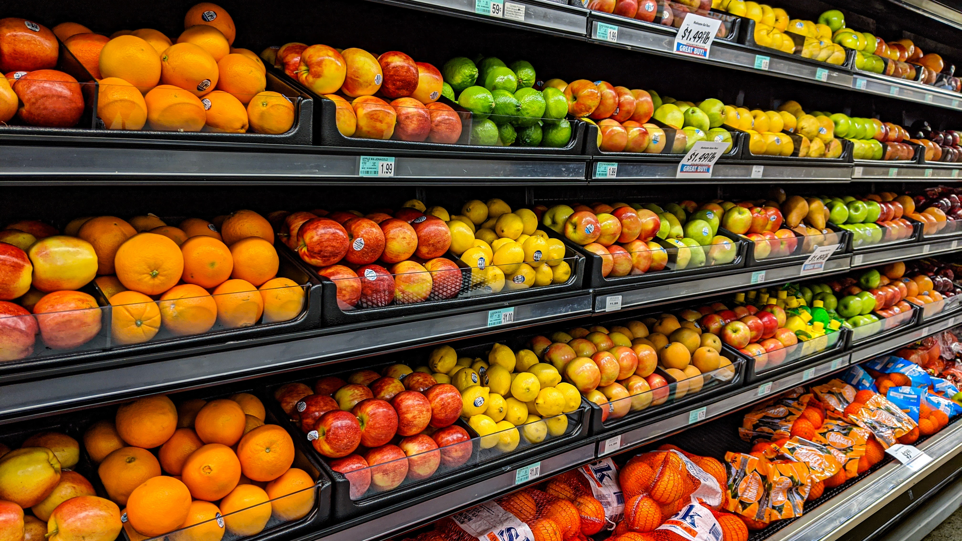

Title
Supermart Grocery Sales Analysis
- Power BI & SQL Project
Retail Analytics
-Barney Sophia

Slide 2

Project Overview- Supermart Grocery Sales
The objective of this project is to explore and analyze a dataset containing information at a supermarket. The dataset includes data on orders placed by customers using a grocery delivery application. It is based on customers living in the state of Tamil Nadu, India.

Slide 3
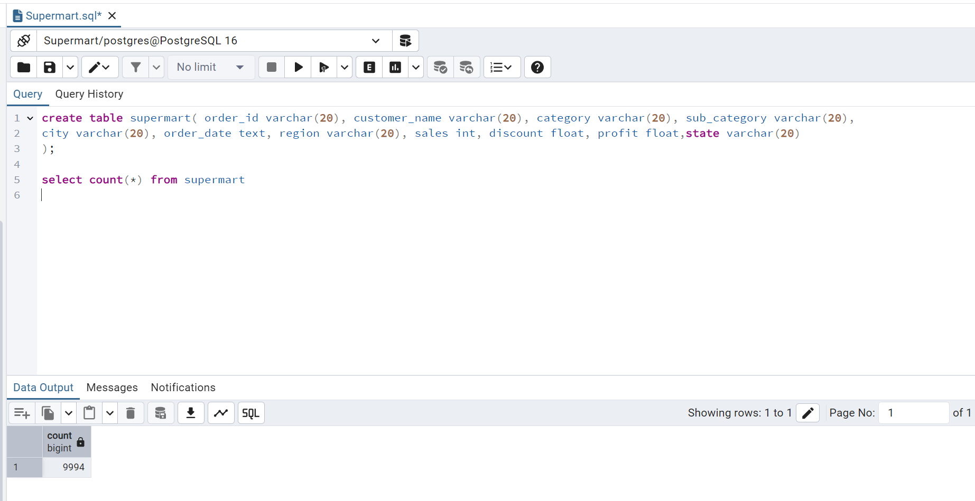
Data Overview

Slide 4

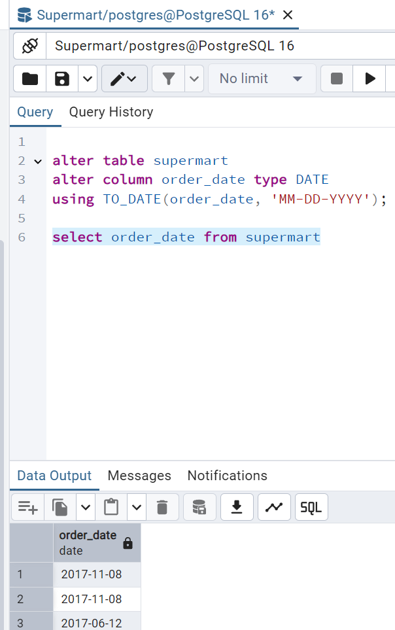
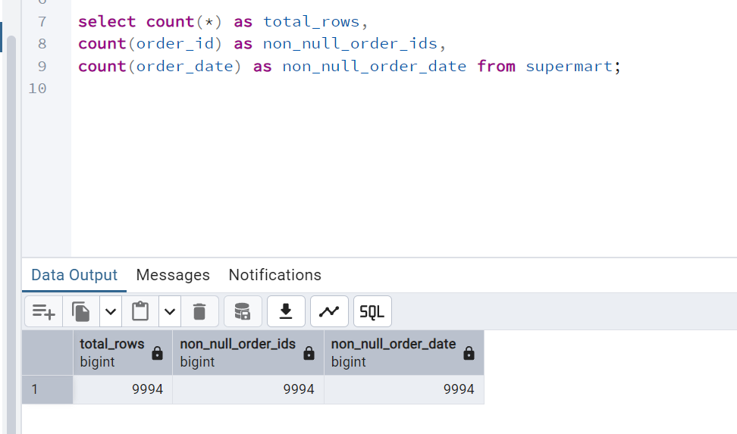
Data Cleaning

Slide 5
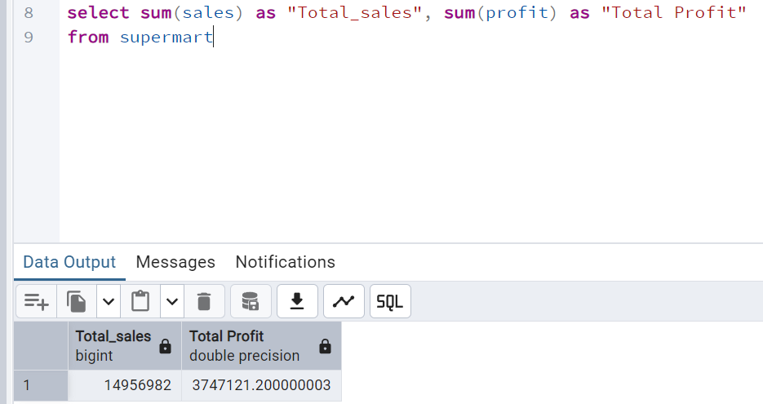

Aggregate Sales and Profit for all Orders

Slide 6
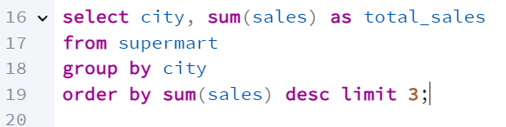
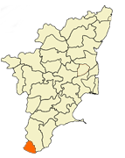
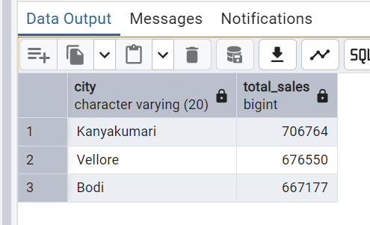
Top 3 Sales-Generating Cities

Slide 7
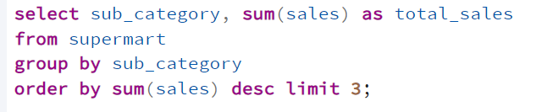

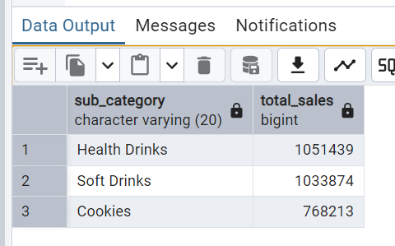
Best-Selling Sub-category based on Sales

Slide 8
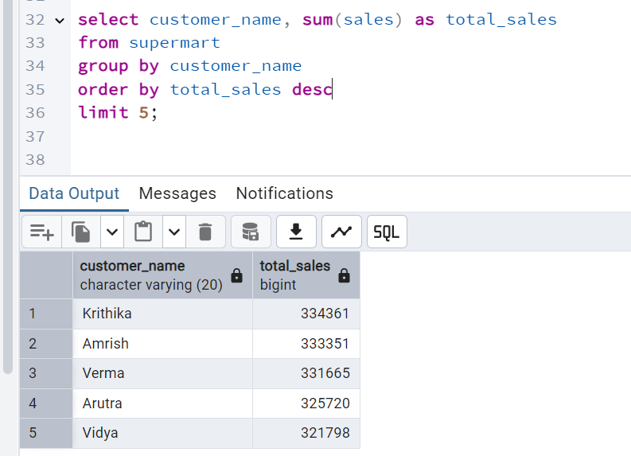

Top 5 customers based on sales

Slide 9
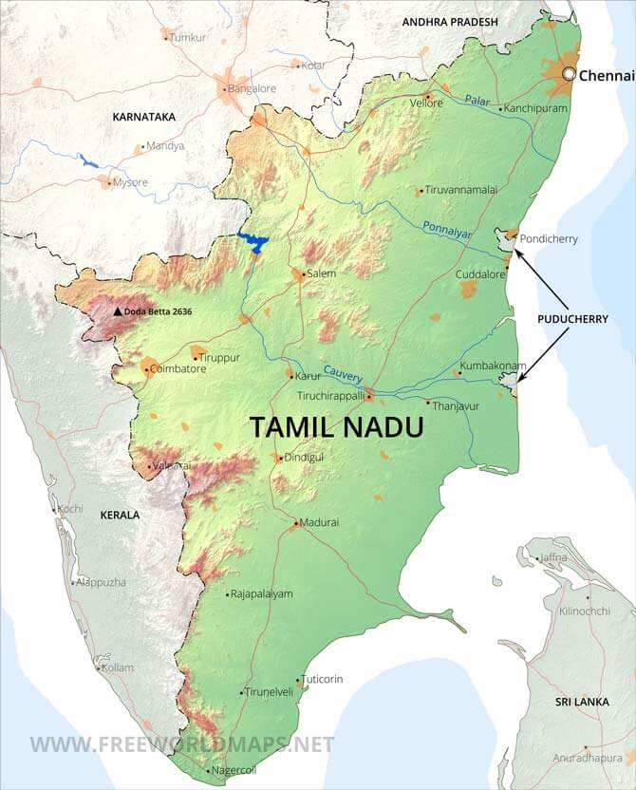
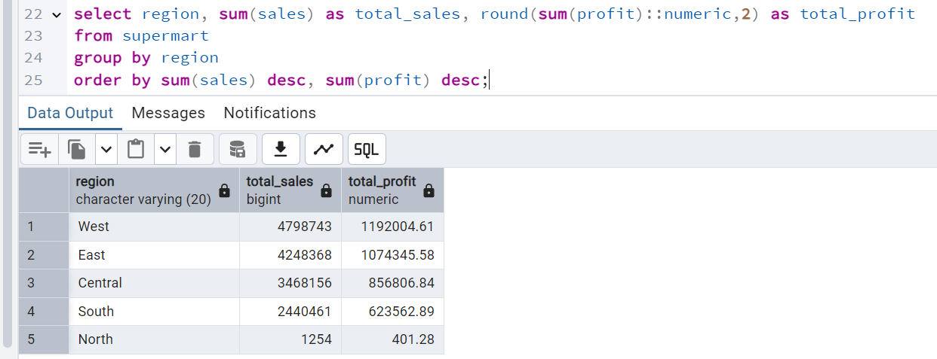
Regional Distribution of Sales and Profit

Slide 10
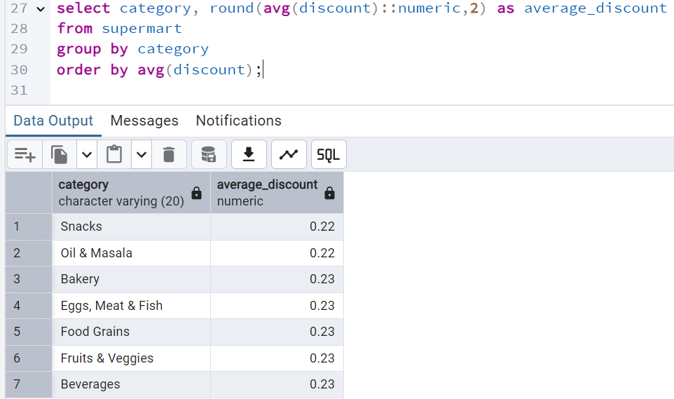

Discount Analysis: Average Across All Orders

Slide 11
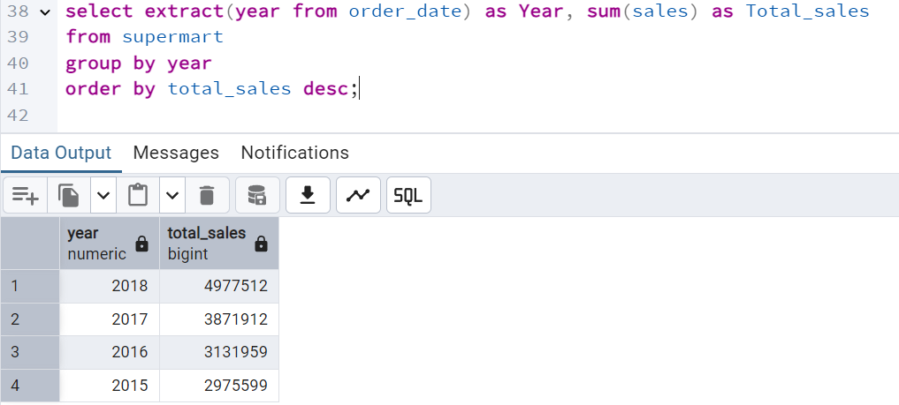
Sales Trend Analysis by year

Slide 12
Power BI Dashboard

Slide 13
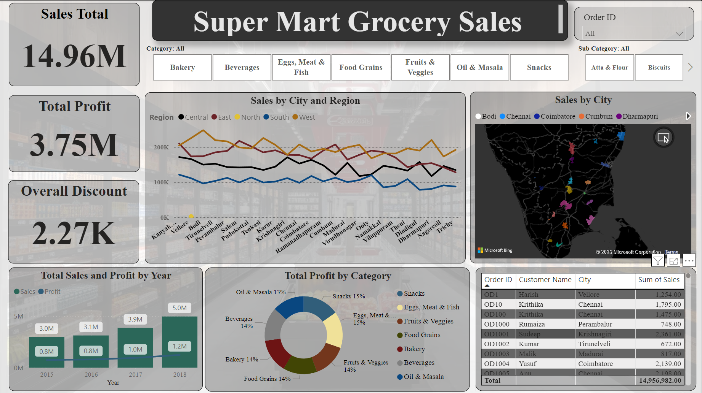

Slide 14
Key Insights:
Total sales amount to 14.96M, with the West (32%) region contributing the most, while the North underperforms with total sales of just 1.25K, indicating a significant gap compared to other regions.
Total profit is 3.75M, accounting for 25% of total sales, with key contributors being Snacks (15%), Eggs, Meat & Fish (15%), and Beverages, Bakery, and Fruits & Veggies (14% each).
The overall discount offered is 2.27K, reflecting minimal promotional activity across regions.
Yearly sales and profit show consistent growth, with 2018 achieving the highest sales (5.0M) and profit (1.2M), demonstrating strong performance trends.
Top-performing cities like Kanyakumari, Vellore and Bodi drive significant sales, while the North region's cities struggle, requiring focused attention and strategies for improvement.

Slide 15
Recommendations:
Concentrate on categories like Snacks, Eggs, Meat & Fish, and Beverages, which collectively contribute 43% of total profit, by increasing marketing efforts and optimizing inventory management.
Develop localized marketing campaigns and tailored product offerings to boost sales in the North region(0.008%), which significantly underperforms compared to other regions.
Introduce targeted discounts to stimulate sales in low-performing areas, while carefully monitoring their impact on profit margins to maintain financial stability.
Analyze and replicate the strategies that drove success in 2018, focusing on scaling operations in high-performing cities like Chennai and Coimbatore to sustain growth.
Focus resources on the best-performing areas, while finding ways to improve sales in the North region and other weaker areas.

